Slide 1
2D Stencil Project PART 1
CSCI 209
Spring 2024
NOTE – IN JAVA ‘-’ (hyphens) are not allowed in class names, so you will need to use underscores ‘_’

Slide 2
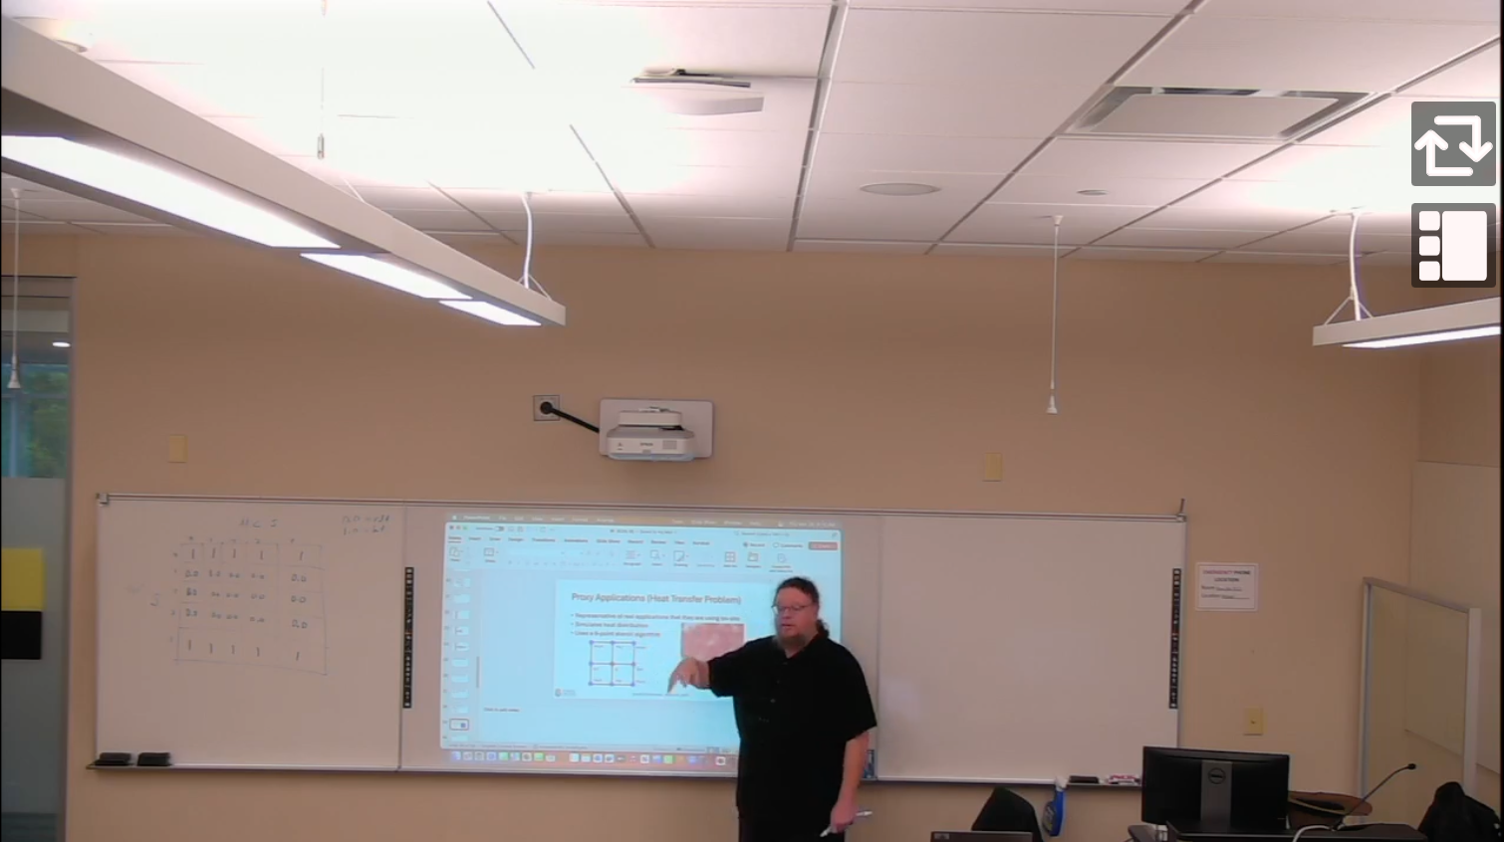
This assignment was discussed in class March 28, 2024
YUJA VIDEO FROM CLASS DISCUSSING ASSIGNMENT
Got back and watch this to review what is needed / why and how it works.

Slide 3
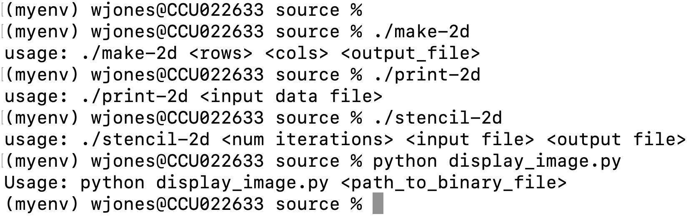



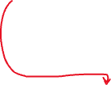
Interface / Workflow
NOTE – IN JAVA ‘-’ (hyphens) are not allowed in class names, so you will need to use underscores ‘_’
You’ll need to run it with the java JVM of course
USE UNDERSCORES INSTEAD
(except of course, it needs to be in java for all but the last one)

Slide 4
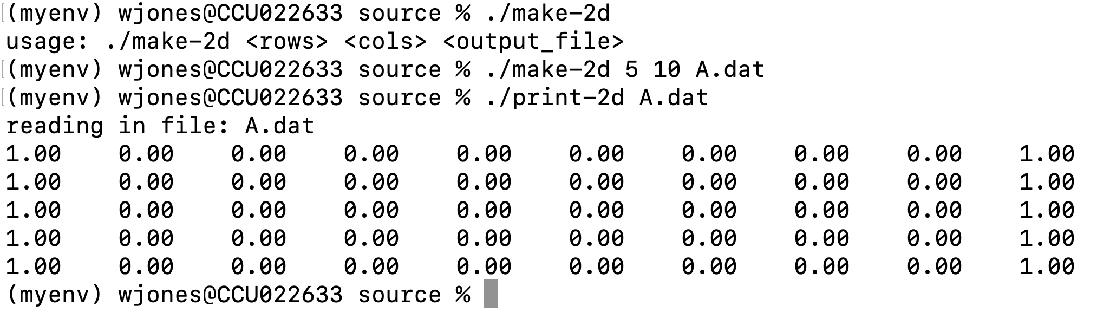


Making example (small) file
USE UNDERSCORES INSTEAD
(boundaries never change, only the interior cells)
Interior cells

Slide 5
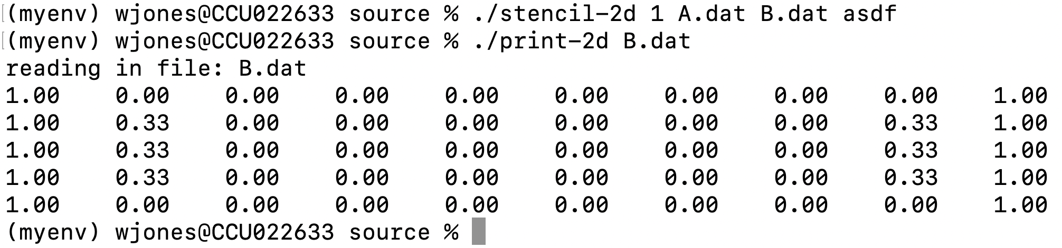

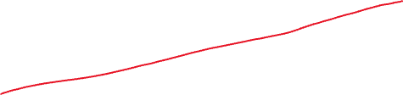


Running 1 iteration of the stencil algorithm
USE UNDERSCORES INSTEAD
Notice the changes in the cells here

Slide 6
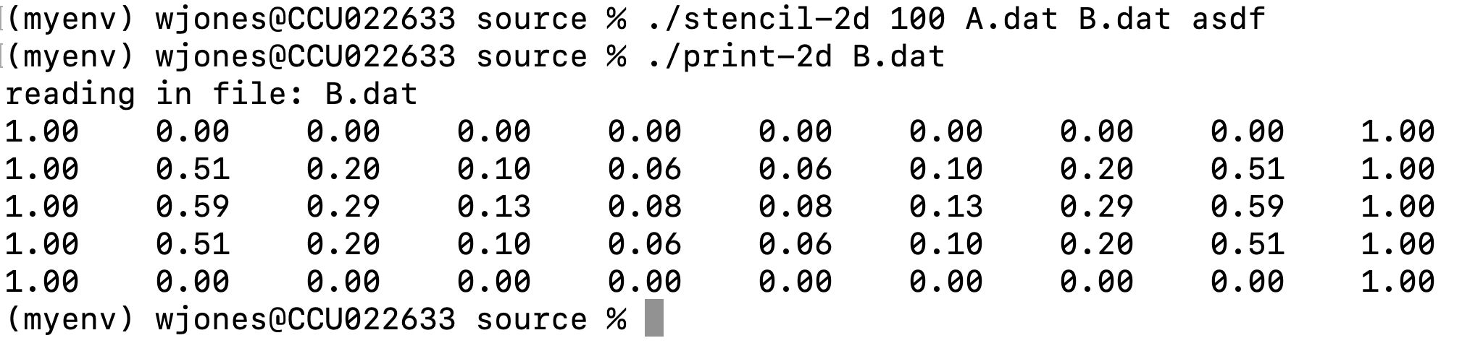


Running 100 iteration of the stencil algorithm
USE UNDERSCORES INSTEAD
Notice the MORE changes in the cells here

Slide 7
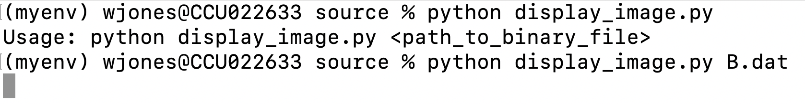
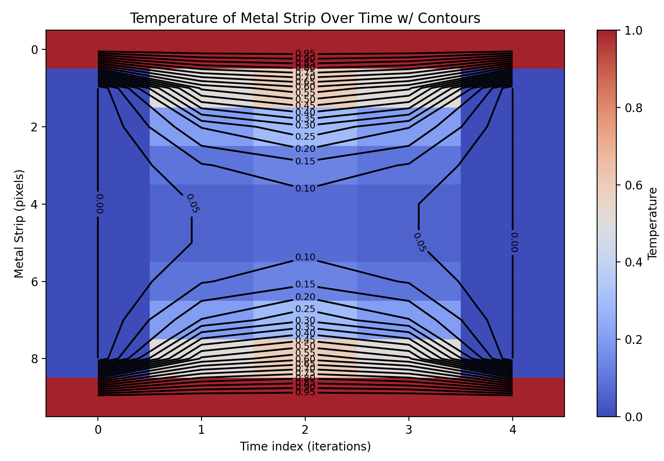
Visualization Prior B.dat (final state) w/ Python
USE UNDERSCORES INSTEAD
Matplotlib will be useful
Google how to do this
Google how to add contours
Make sure to label axes

Slide 8
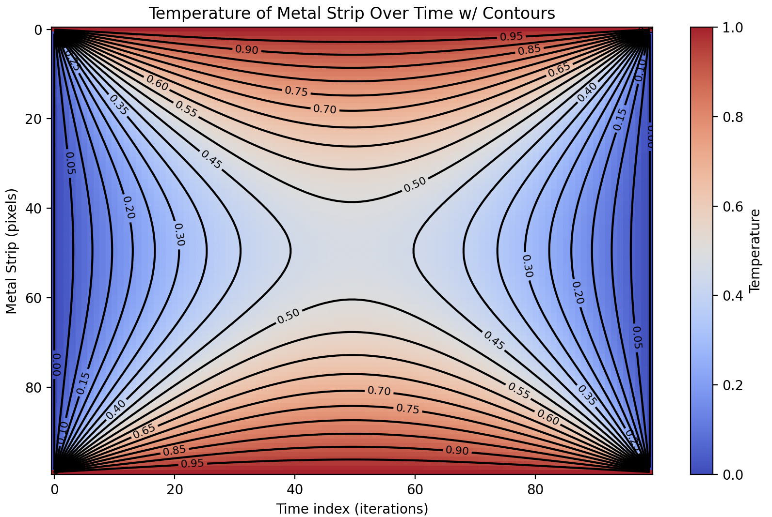
Operation with 100x100 @ 5K iterations
USE UNDERSCORES INSTEAD

Slide 9
Timing and performance
Timing
Measure overall, work, and IO time
Run a few sizes of N (all powers of two between 128 and 2048, inclusive) where the number of iterations is set to 100 and measure these times and plot them, X axis is N and Y axis is time. There should be 3 curves. Use a python script, called plot_data.py to plot this (not shown in class)

Slide 10
Submission
There will be a folder structure, like discussed in class
./hw07-P1
./code // java and python scripts here
./data
./report // PPT report (not Word)
Make a detailed report (PPT) discussing everything, showing it working, results, etc. Prove that it can do everything that I mentioned in class. Zip and submit to Moodle.

